Slide 1
Botswana RHT Site Certification The journey to date

Slide 2
Outline
Overview of country tester certification
Structure of certification program
National curriculum
Tool used for certification data management
Lessons learnt

Slide 3
Stepwise Process to Certification – 1
Training of TOTs
Development of training plan
Training needs based on gaps identified through CQI projects and program needs
TOTs deliver competency-based training
Testers not attaining competency are followed, retrained and reassessed by assigned master Trainer.
Mentorship, and site support towards site accreditation
Data management
RHTCQI – PT, QC
Site certification
Currently site reaching level 4 rating not certified due to no certification body & framework
Use standardized training curriculum to upskill Master Trainers to TOT level
SPi-RRT tool to conduct site assessments
Use ODK installed on tablets to conduct assessment
Grading of different components of RTCQI RHT sites.
Data management: (SPI-RRT dashboards)

Slide 4
Stepwise Process to Tester Certification - 2
March 2018
Initial Training of 10 LMTs on SPI-RRT by CDC Atlanta
June 2018
109 SPI-RRT sites audited
August 2023
256 SPI-RRT sites audited
March 2019
In-country SPI-RT Training of 15 additional TOTs
2010
Development of TOT curriculum
2010
Inception of LMT Program
Initial training of LMTs
2018 – 2019 Review of National Curriculum for TOTs and testers
2012
PT Panel Production for testers by
BNQAL
Training of POCT testers (PMTCT lay counsellors, HCWs)
Continuous mentorship & support of testing sites by LMTs

Slide 5
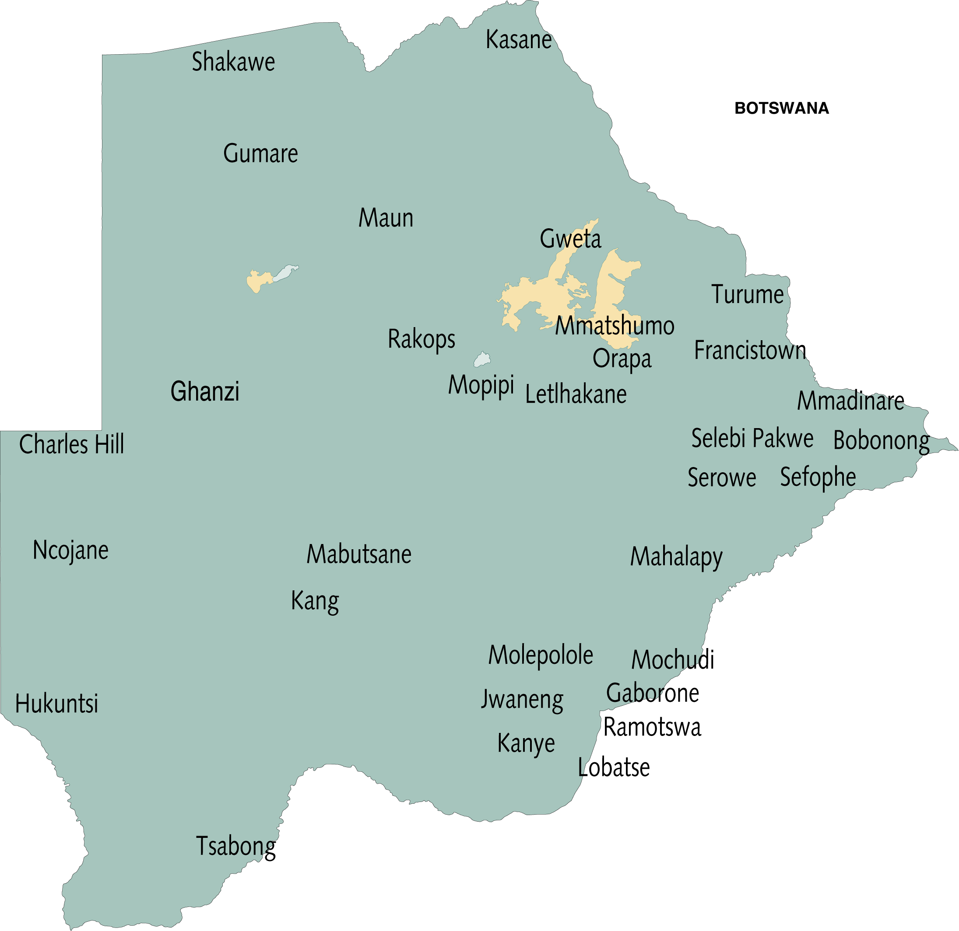
2024 Lab Master Trainer & Auditor distribution
Key
Lab Master trainer
SPI-RRT Auditor
BNQAL
Nata
Masunga
84 Lab Master trainers
Of which are 18 SPI-RRT auditors
Based at
48 government labs
1 private lab
2 Implementing partners
Palapye
Sefhare
Goodhope

Slide 6
National SPI-RRT Performance

Slide 7
Structure of Certification Program
Ministry of Health
Department of Technical Support Services
Centre for Disease Control – Botswana
MoH National Health Laboratory
University of Botswana
Oversight
Technical Advisory & Certification Body
Implementers
Bummhi
Resources
National curriculum
Trained TOT’s
SPI-RRT Auditors
Lab Master trainers
District focal persons
Training of testers
PT testing participation and performance
Quality control
Standardized log books
Standardized quality assurance tools
Equipment (timers, thermometers)

Slide 8
National curriculum Development & Implementation
National Curriculum Development
All HIV Point of Care testing curriculum is developed by Ministry of Health by the POCT TWG (Lab) and HTS TWG (Counselling).
TWGs consist of technical advisors and SPI-RRT auditors from stakeholders including implementing partners, PEPFAR agencies ie. USAID and CDC, NAPHA
Laboratory Master Trainers
The laboratory master trainer are lab technologists based at district laboratories and implementing partners
Perform direct observations, corrective actions, support/mentorship visits, monitor stock levels, monitor indicators,
Training HTS providers on testing/laboratory component
HTS Focal Persons
Program officers at districts who coordinate HTS programming activities
Provides technical oversight on counselling
Use curriculum to train HTS on counselling component
District Monitoring & Evaluation Officers
Monitors reporting by facilities and partners and analyse districts data to report to relevant stake holders
Train HTS providers on HTS electronic Medical Records EMRs such as IPMS, dHIS2, PIMS, ODK
HTS Providers
HTS providers include; Testers Key Population Peer Outreach Workers, HIVST distributors
Provide education and counselling to clients seeking testing through health talks
Community/Clients
Receive information on testing services & ask questions to gain comprehensive understanding.

Slide 9
Data Management Tools
ODK App with SPI-RRT checklist v4.0 configured on tablets and used during audits
Completed audit data with geo-coordinates is synced to Cloud Server at National Health Lab
Data visualisation on SPI-RRT Dashboard

Slide 10
Lessons Learnt
In-country training of TOTS as SPI-RRT auditors
Staff attrition, logistics
Need to train more LMTs/TOTs as SPI-RRT auditors
Assessment need for mobile & outreach testing settings
Mobile & Outreach testing by CSOs, IPs significantly increased
Need for standardized assessment checklist for testing settings
Stakeholder engagement & collaboration
Previous challenges with identifying certification body
Collaboration resolved previous challenges to site certification

Slide 11
Way Forward COP23 Q3 -Q4
Engaged University of Botswana as certification body
Finalize the budget work plan
Establish the exact number of target sites
Select the pool assessors based on target sites
MOH and Bummhi to prioritize sites for mentorship & assessment
Site certification
Certification of sites by UB
RTCQI certification scope of work developed
Workplan developed
MOU between MOH and UB
Conduct the assessments
Refresher training for the assessors
Offered through TA from CDC Atlanta
Targeted sites assessed
SPIRRT dashboards

Slide 12
KE A LEBOGA!

